Slide 1
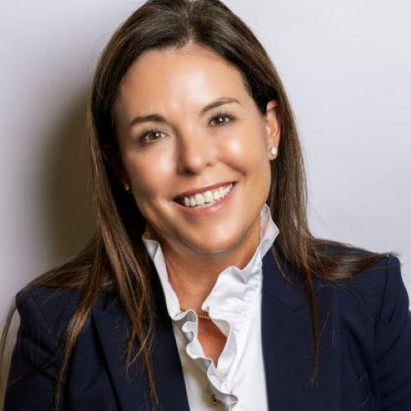
TEAMWORK AS A SCIENCE
WENDY MILLER
Chief People Officer –
North America
McKinsey & Company

Slide 2
TEAMWORK AS A SCIENCE:
How to use data to build high performing teams
WENDY MILLER

Slide 3
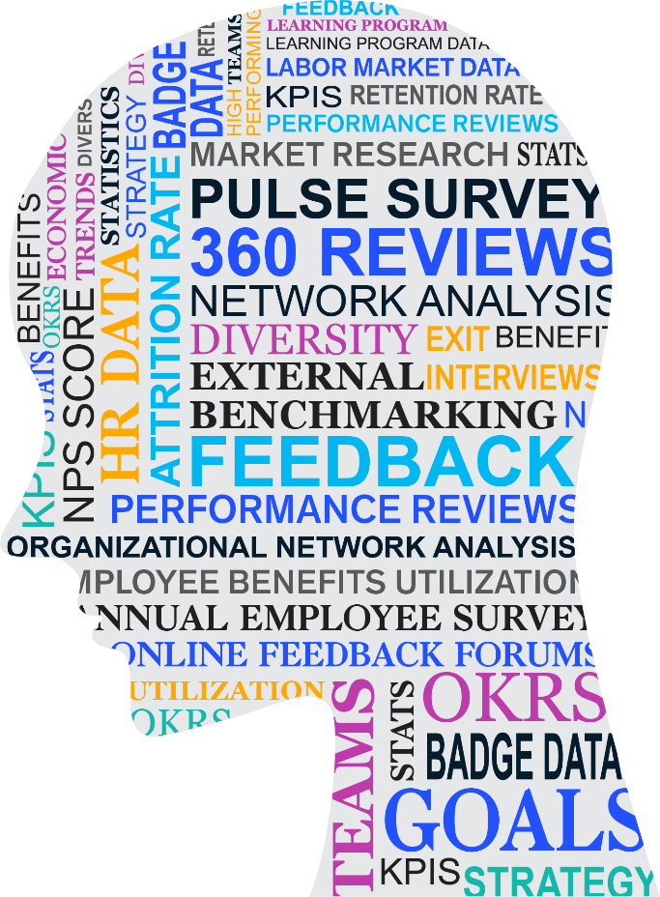
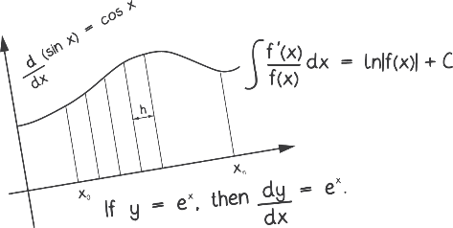
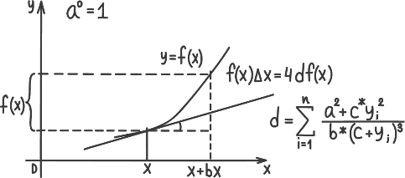
Data, data, and more data

Slide 4
What does it take?
People analytics team
Way We Work rituals
Partnering with business leaders
Surveys

Slide 5
Surveys
Survey
Role in data collection
Weekly Pulse
Continuous listening
“Canary in the coal mine”
Biweekly Engagement Team
Measure team effectiveness and experience
Track ritual adoption and impact
Provide real-time feedback to team leaders
Identify teams that need intervention
Client
Measure key business objective: client impact and experience
Determine teams that are most effective for clients
Annual Organizational Health Index (OHI)
Measure and predict long-term performance and trends

Slide 6
The Way We Work: 4 core rituals for teams
2
3
4
1
Strong Kickoffs
Recurring 1:1s
Regular Retros
High Impact Handovers
Teams that practice these rituals have up to +23 points higher client satisfaction and +49 points in team satisfaction

Slide 7
The Way We Work: 4 core rituals for teams
1
Strong Kickoffs

Slide 8
The Way We Work: 4 core rituals for teams
2
Recurring 1:1s

Slide 9
The Way We Work: 4 core rituals for teams
3
Regular Retros

Slide 10
The Way We Work: 4 core rituals for teams
4
High Impact Handovers

Slide 11
The Way We Work: 4 core rituals for teams
2
3
4
1
Strong Kickoffs
Recurring 1:1s
Regular Retros
High Impact Handovers
Teams that practice these rituals have up to +23 points higher client satisfaction and +49 points in team satisfaction

Slide 12
People analytics team
Look across multiple data sets
Apply advanced analytics methods
Understand organizational context to provide insights

Slide 13
Partnering with business leaders
Business leaders bring
People analytics brings
Data literacy
Data summarized into insights that can be a starting point for action
Realistic solutions that will work in practice
Recommendations for “hot spots” to address
Ability to make decisions based on data insights
Underlying details and drivers
Resources to enact change

Slide 14
Co-locating 50% of the time is the “hybrid sweet spot” for our teams
Mentorship and apprenticeship
Retention
Collaboration
3x
25%
10x
More likely to stay
Increase in satisfaction with support
Report they collaborated effectively
More likely to receive feedback and have 1:1s
Sources: Way We Work and Client Analytics research, including 60,000+ engagement team survey responses from on-average 4,000 concurrent teams; Data from a range of sources, including Mentorship and Sponsorship survey, ambient, and behavioral; 70+ structured assessments team members across roles and tenures; Live engagement with 40+ teams, including 217 consultants

Slide 15
Team Leader Summit
94%
89%
86%
Recommendation rate
Felt more confident that they will be able to focus on success of clients and teams
Felt more empowered as leaders
Pulse survey improvement:
Positive sentiment attendees the (+5%) negative sentiment decreased (-1%), compared to those that did not attend
Source: EOP Survey; n=87

Slide 16
What can you start tomorrow?
#
S
H
R
M
2
4
#
S
H
R
M
E
x
e
c
u
t
i
v
e
N
e
t
w
o
r
k

Slide 17
What are you trying to solve? What bold moves do you need to make to solve it with data?
#
S
H
R
M
2
4
#
S
H
R
M
E
x
e
c
u
t
i
v
e
N
e
t
w
o
r
k

